Slide 1
Digital Signature

Slide 2
Introduction
Differences between conventional signatures and digital signatures.
Signature Generation
A conventional signature is included in the document; it is part of the document.
But when we sign a document digitally, we send the signature as a separate document.

Slide 3
Introduction…
Signature Verification
For a conventional signature, when the recipient receives a document, she compares the signature on the document with the signature on file.
For a digital signature, the recipient receives the message and the signature. The recipient needs to apply a verification technique to the combination of the message and the signature to verify the authenticity.

Slide 4
Introduction…
Relationship
For a conventional signature, there is normally a one-to-many relationship between a signature and documents.
For a digital signature, there is a one-to-one relationship between a signature and a message.
Duplicity
In conventional signature, a copy of the signed document can be distinguished from the original one on file.
In digital signature, there is no such distinction unless there is a factor of time on the document.

Slide 5
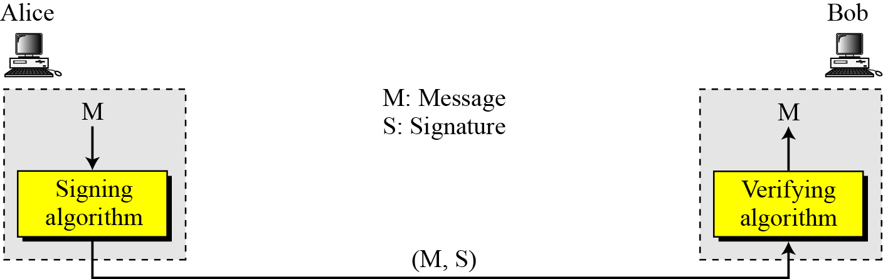
Digital Signature: Process

Slide 6
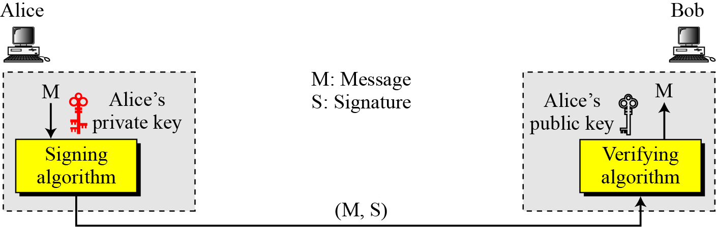
Need for Keys
A digital signature needs a public-key system.
The signer signs with her private key; the verifier verifies with the signer’s public key.

Slide 7
Need for Keys…
A cryptosystem uses the private and public keys of the receiver: a digital signature uses
the private and public keys of the sender.

Slide 8
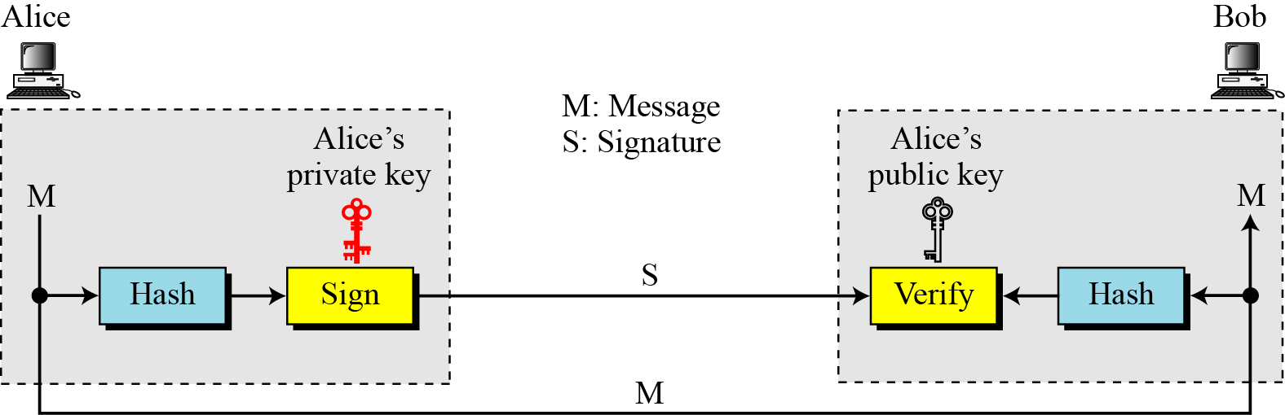
Signing the digest

Slide 9
Security Services offered by digital signature
Message confidentiality
Message authentication,
Message integrity
Nonrepudiation
A digital signature can directly provide the last three;
for message confidentiality we still need encryption/decryption.

Slide 10
Message Authentication
A secure digital signature scheme, like a secure conventional signature can provide message authentication.
A digital signature provides message authentication.

Slide 11
Message Integrity
The integrity of the message is preserved even if we sign the whole message because we cannot get the same signature if the message is changed.
A digital signature provides message integrity.

Slide 12
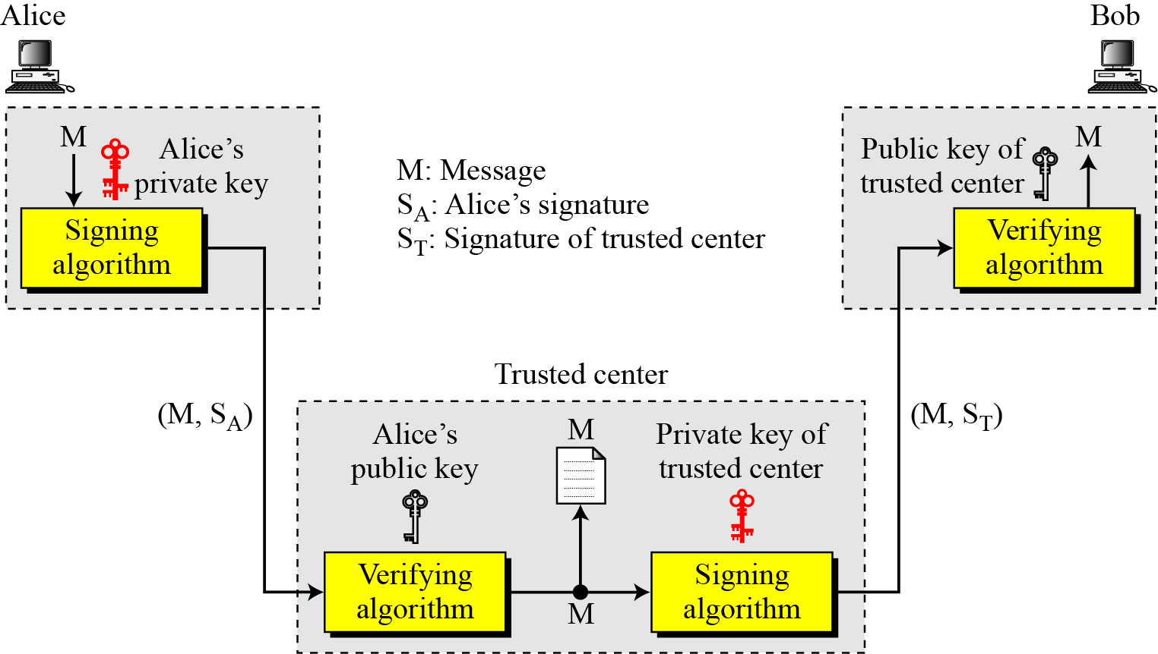
Nonrepudiation
Nonrepudiation can be provided using a trusted party.

Slide 13
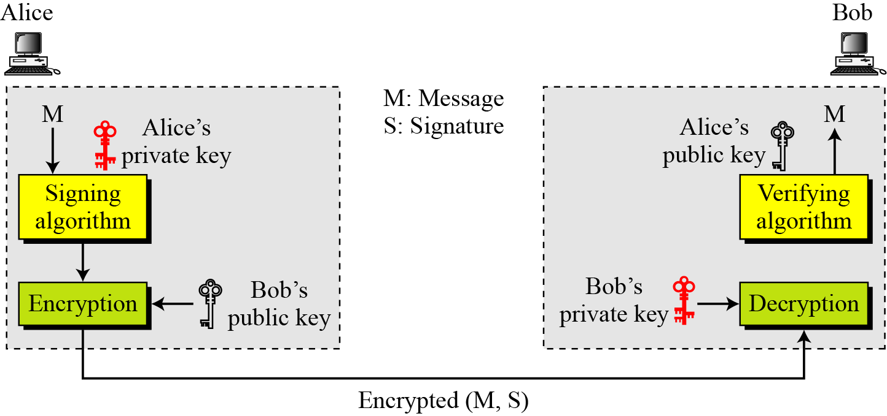
Confidentiality
A digital signature does not provide confidentiality.
If there is a need for confidentiality, another layer of encryption/decryption must be applied.

Slide 14
Attack types
Key-Only Attack
the attacker is only given the public verification key.
Known-Message Attack
the attacker is given valid signatures for a variety of messages known by the attacker but not chosen by the attacker.
Chosen-Message Attack
the attacker first learns signatures on arbitrary messages of the attacker's choice.

Slide 15
Forgery Types
Existential Forgery
Existential forgery is the creation (by an adversary) of any message/signature pair (m,σ), where σ was not produced by the legitimate signer.
Selective Forgery
Selective forgery is the creation (by an adversary) of a message/signature pair (m,σ) where m has been chosen by the adversary prior to the attack.

Slide 16
Digital Signature Schemes

Slide 17
Digital Signature Schemes
RSA Digital Signature Scheme
ElGamal Digital Signature Scheme
Schnorr Digital Signature Scheme
Digital Signature Standard (DSS)
Elliptic Curve Digital Signature Scheme

Slide 18
RSA Digital Signature Scheme
Key Generation
Key generation in the RSA digital signature scheme is exactly the same as key generation in the RSA
In the RSA digital signature scheme, d is private; e and n are public.

Slide 19
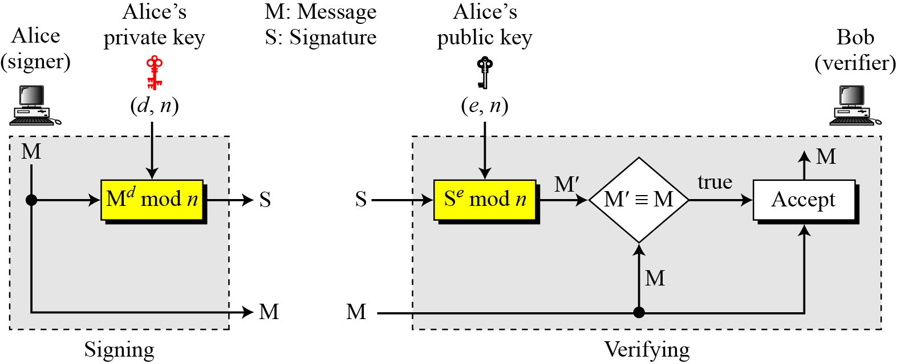
RSA Digital Signature Scheme…

Slide 20
RSA Digital Signature Scheme…
As a trivial example, suppose that Alice chooses p = 823 and q = 953, and calculates n = 784319. The value of φ (n) is 782544. Now she chooses e = 313 and calculates d = 160009. At this point key generation is complete. Now imagine that Alice wants to send a message with the value of M = 19070 to Bob. She uses her private exponent, 160009, to sign the message:
Alice sends the message and the signature to Bob. Bob receives the message and the signature. He calculates
Bob accepts the message because he has verified Alice’s signature.

Slide 21
RSA Digital Signature Scheme…
Key only attack:
Eve has access only to Alice’s public key. Eve intercepts the pair (M,S) and tries to create another message M’ such that it generates the same S
Known-message attack:
Eve intercepts two message signature pairs (M₁, S₁) and (M₂, S₂) that have been created using same private key. Can Eve find Signature on the message M₁xM₂?
Chosen-message attack:
What if Eve convince Alice to sign M₁ and M₂ chosen by her? Is this selective forgery or existential ?

Slide 22
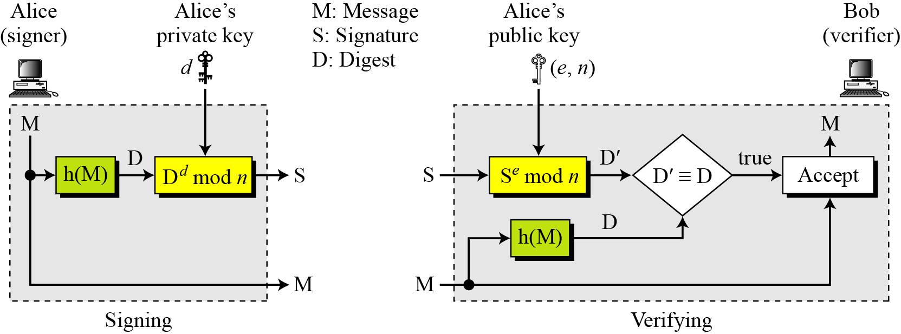
RSA Digital Signature Scheme…
RSA Signature on the Message Digest

Slide 23
RSA Digital Signature Scheme…
When the digest is signed instead of the message itself, the susceptibility of the RSA digital signature scheme depends on the strength of the hash algorithm.
Can you justify the above statement?

Slide 24
RSA Digital Signature Scheme…
Key only attack:
Eve intercepts the pair (M,S) and tries to create another message M’ such that it creates the same digest !!!
Eve finds two messages M₁ and M₂ such that they hash to same value !!!
Known-message attack:
Eve intercepts two message signature pairs (M₁, S₁) and (M₂, S₂) that have been created using same private key. Can Eve find Signature on the message M₁xM₂?
Can Eve find the message M = M₁xM₂?
Chosen-message attack:
What if Eve convince Alice to sign M₁ and M₂ chosen by her?
Can Eve find the message M = M₁xM₂?

Slide 25
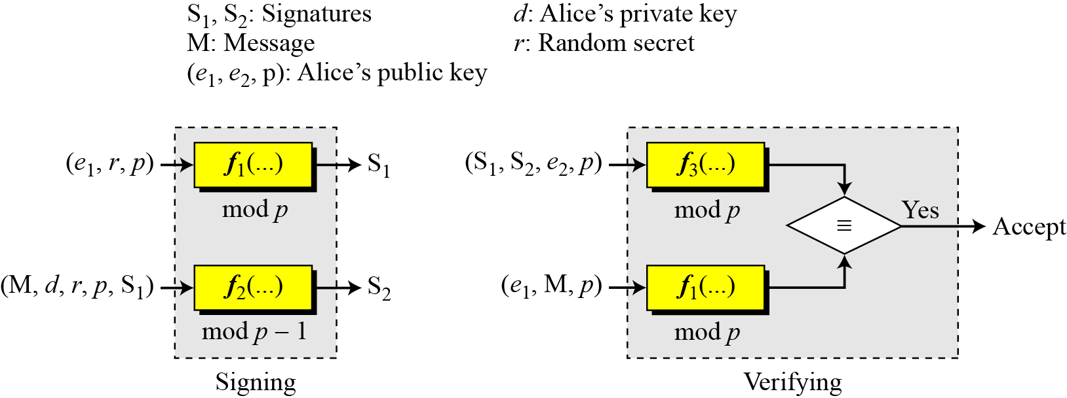
ElGamal Digital Signature Scheme
e₂ = e₁^{d}mod p.

Slide 26
ElGamal Digital Signature Scheme…
Key Generation
The key generation procedure here is exactly the same as the one used in the cryptosystem.
In ElGamal digital signature scheme, (e₁, e₂, p) is Alice’s public key; d is her private key.

Slide 27
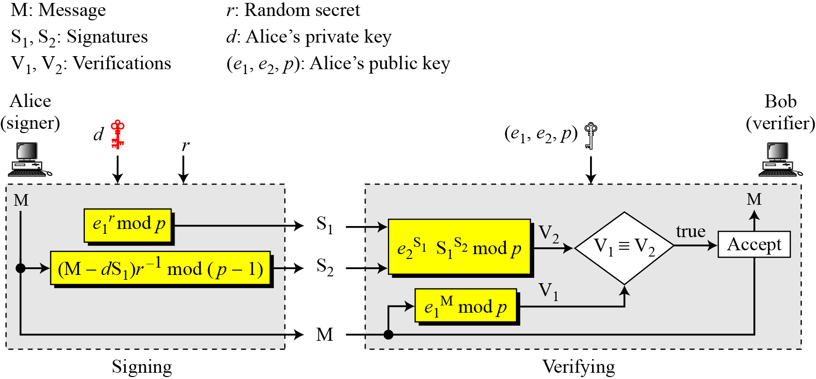
ElGamal Digital Signature Scheme…

Slide 28
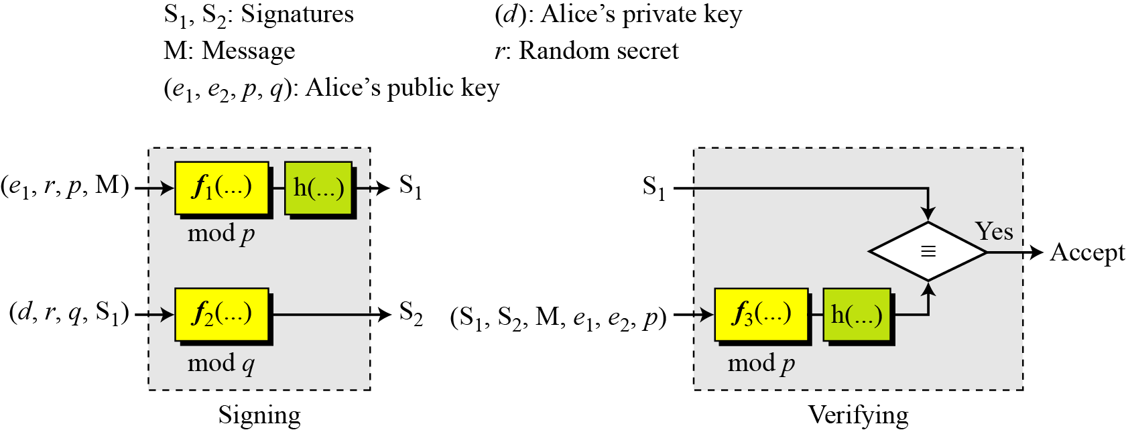
Schnorr Digital Signature Scheme

Slide 29
Schnorr Digital Signature Scheme…
Key Generation
Alice selects a prime p, which is usually 1024 bits in length.
Alice selects another prime q.
Alice chooses e₁ to be the qth root of 1 modulo p.
Alice chooses an integer, d, as her private key.
Alice calculates e₂ = e₁^{d} mod p.
Alice’s public key is (e₁, e₂, p, q); her private key is (d).
In the Schnorr digital signature scheme, Alice’s public key is (e₁, e₂, p, q); her private key (d).

Slide 30
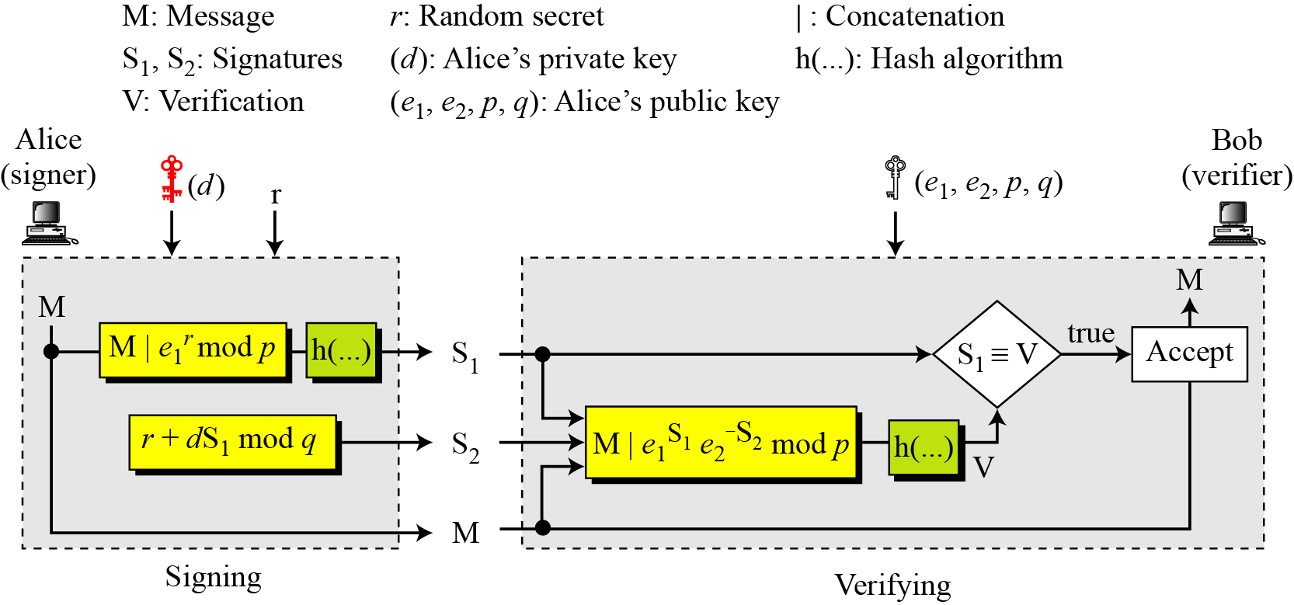
Schnorr Digital Signature Scheme…

Slide 31
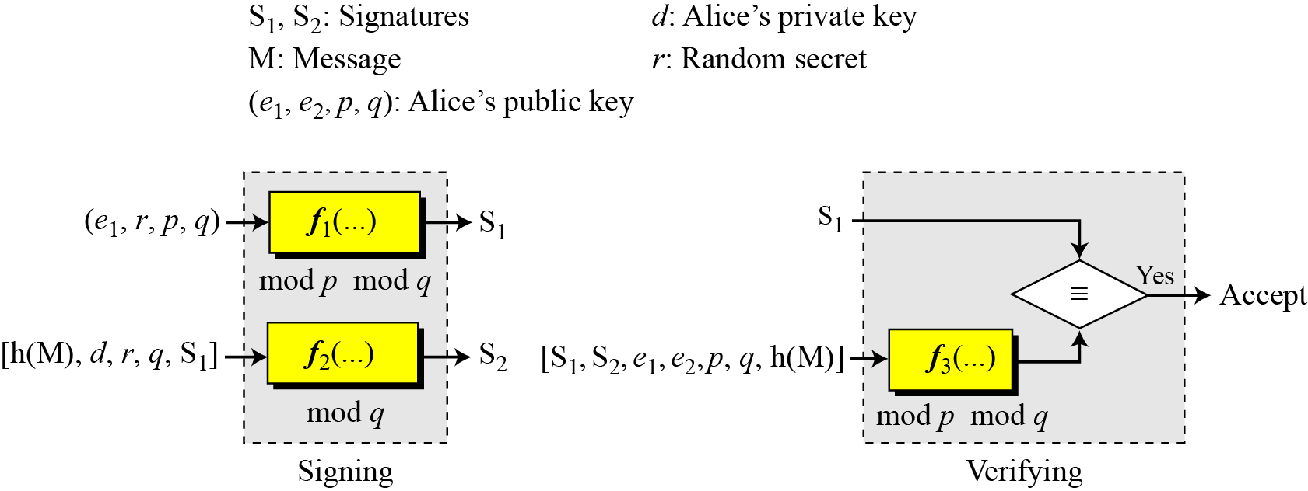
Digital Signature Standard (DSS)

Slide 32
Digital Signature Standard (DSS)…
Key Generation.
Alice chooses primes p and q.
Alice uses <Z_{p}*, × > and <Z_{q}*, ×>.
Alice creates e₁ to be the qth root of 1 modulo p.
Alice chooses d and calculates e₂ = e₁^{d}.
Alice’s public key is (e₁, e₂, p, q); her private key is (d).

Slide 33
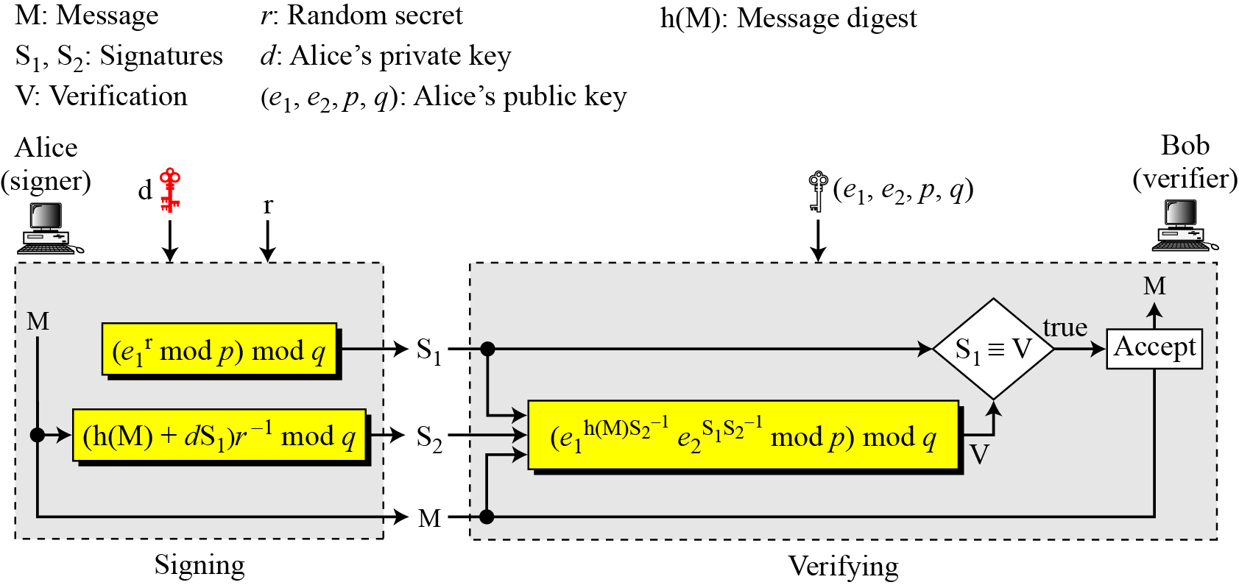
Digital Signature Standard (DSS)…

Slide 34
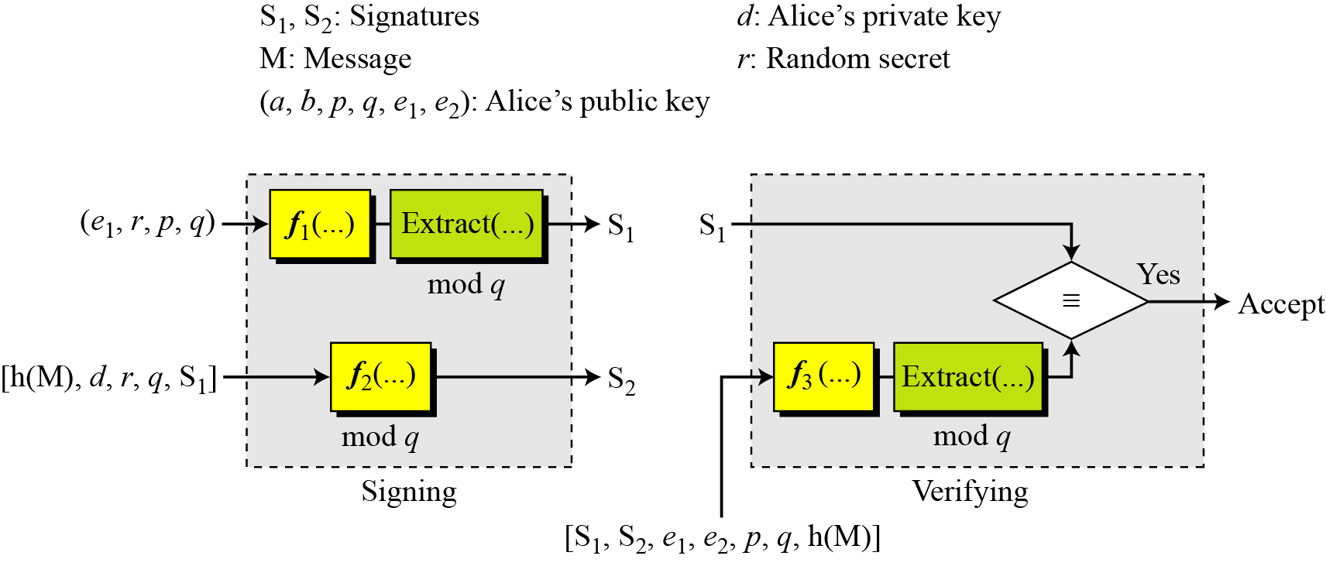
Elliptic Curve Digital Signature Scheme

Slide 35
Elliptic Curve Digital Signature Scheme…
Key Generation
Key generation follows these steps:
Alice chooses an elliptic curve E_{p}(a, b).
Alice chooses another prime q the private key d.
Alice chooses e₁(…, …), a point on the curve.
Alice calculates e₂(…, …) = d × e₁(…, …).
Alice’s public key is (a, b, p, q, e1, e2); her private key is d.

Slide 36
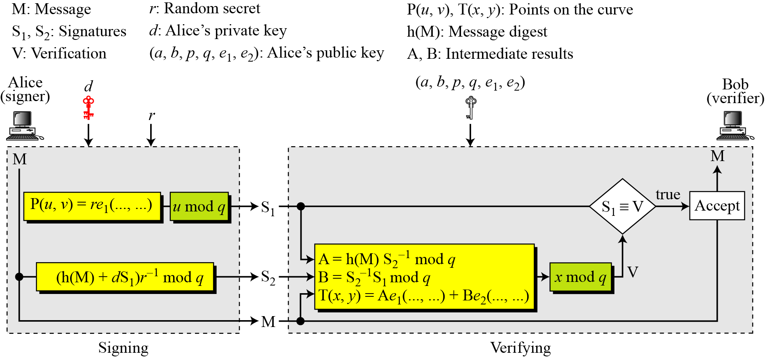
Elliptic Curve Digital Signature Scheme…

Slide 37
Variations
Time Stamped Signatures
Sometimes a signed document needs to be time stamped to prevent it from being replayed by an adversary. This is called time-stamped digital signature scheme.
Blind Signatures
Sometimes we have a document that we want to get signed without revealing the contents of the document to the signer.

Slide 38
Thank you !!!

